Slide 1






Lecture 05
Computer Maintenance and Troubleshooting
CT4005NI - Computer Hardware and Software Architectures

Slide 2

6. Introduction
This chapter introduces preventive maintenance and the troubleshooting process.
Preventive maintenance is a regular and systematic inspection, cleaning, and replacement of worn parts, materials, and systems.
It helps to prevent failure of parts, materials, and systems.

Slide 3
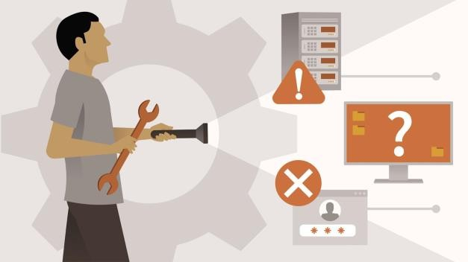
6. Introduction
This chapter introduces preventive maintenance and the troubleshooting process.
Troubleshooting is a systematic approach to locating the
cause of a fault in a computer system.
Not all troubleshooting processes are the same, and technicians tend to refine their own troubleshooting skills based on knowledge and personal experience.

Slide 4
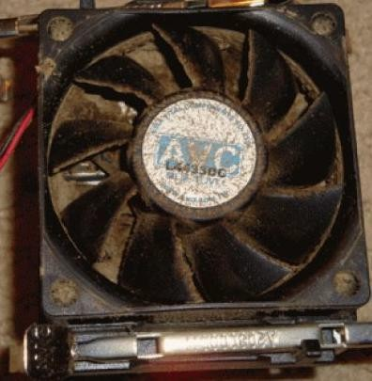
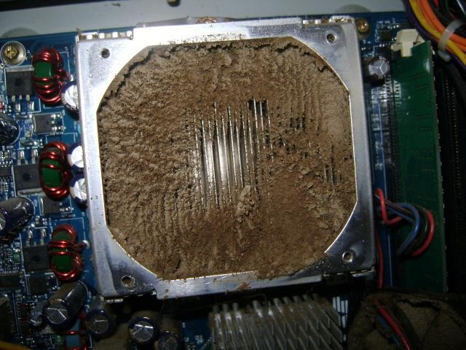
The cigarette computer

Slide 5
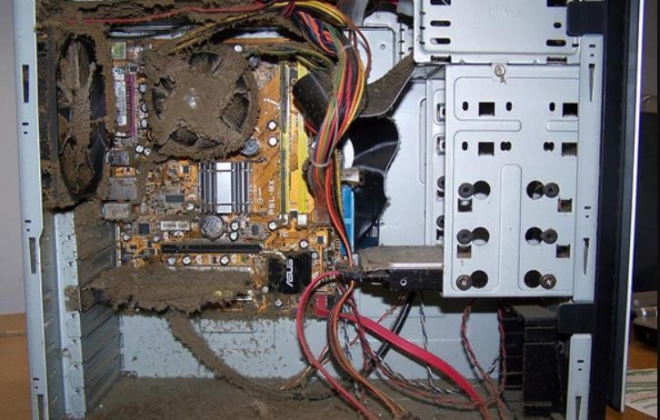
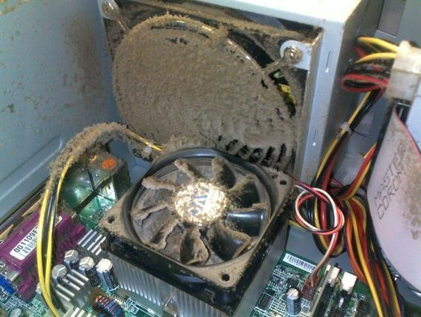
Dust

Slide 6
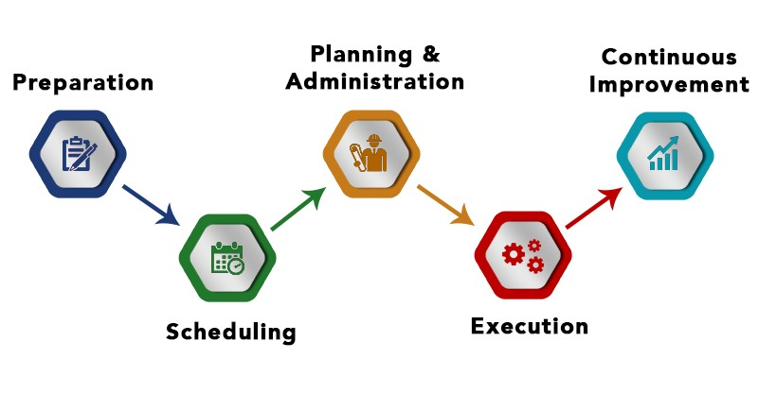
6.1 Explain the Purpose of Preventive Maintenance
Preventive maintenance emphasizes regularly scheduled maintenance tasks.
The goal of preventive maintenance is to give an asset the care it requires while it's still running.
Hardware Maintenance
Software Maintenance

Slide 7
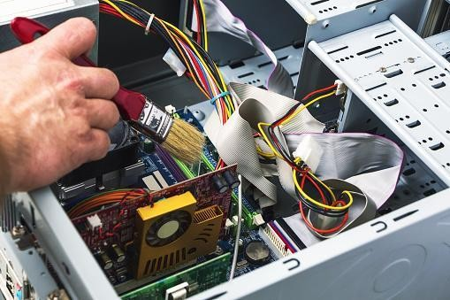
6.1.1 Hardware Maintenance
Computer hardware maintenance involves taking care of the computer's physical components, such as its keyboard, hard drive and internal CD or DVD drives.
Cleaning the computer, keeping its fans free from dust, and defragmenting its hard drives regularly are all parts of a computer hardware maintenance program.

Slide 8
6.1.1 Hardware Maintenance
Hardware Maintenance steps
Remove dust from fan intakes
Remove dust from power supply
Remove dust from components inside the computer
Clean mouse and keyboard
Check and secure any loose cables

Slide 9
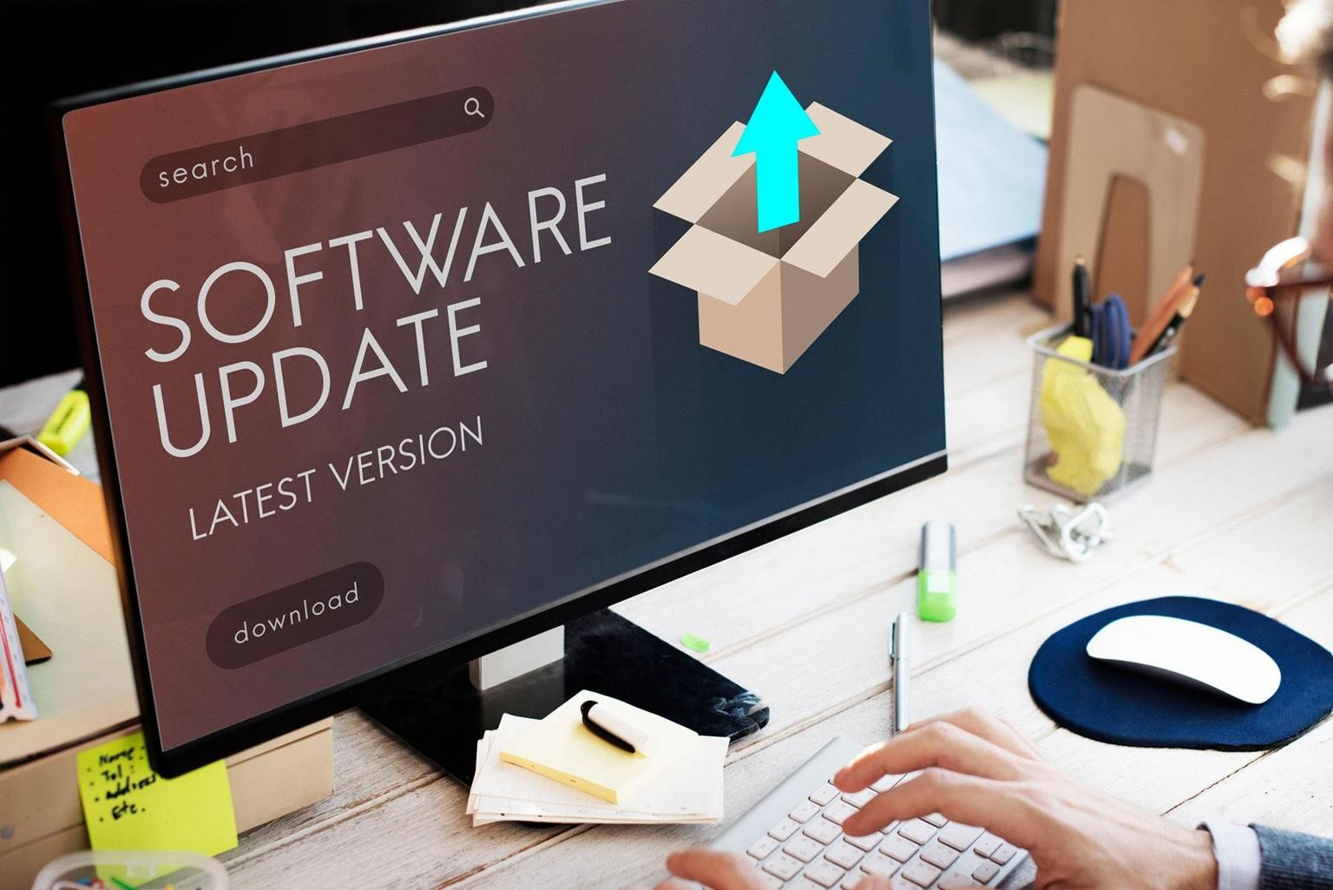
6.1.2 Software Maintenance
Software maintenance is the modification of a software product after delivery to correct faults, to improve performance or other attributes.
A common perception of maintenance is that it merely involves fixing defects.

Slide 10
6.1.2 Software Maintenance
Software Maintenance steps
Review security updates
Review software updates
Review driver updates
Update virus definition files
Scan for viruses and spyware
Remove unwanted program
Scan hard drives for errors
Defragment hard drives

Slide 11
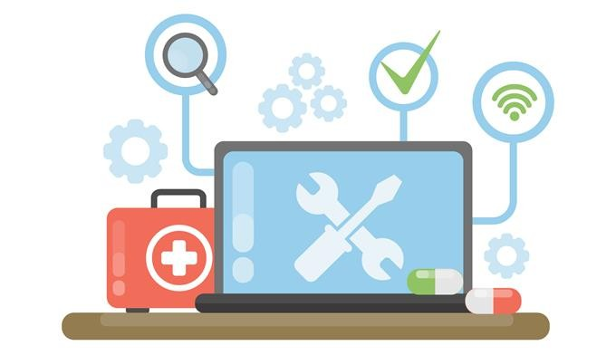
6.1.3 Preventive Maintenance Benefits
Increases data protection
Extends the life of the components
Increases equipment stability
Reduce repair costs
Reduce the number of equipment failures

Slide 12
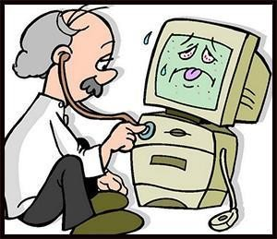
6.2 Identify the steps of the Troubleshooting process
Troubleshooting is a form of problem solving, often applied to repair failed products or processes on a machine or a system.
It is a logical, systematic search for the source of a problem in order to solve it, and make the product or process operational again.
Troubleshooting is needed to identify the symptoms.

Slide 13
6.2 Identify the steps of the Troubleshooting process
Following are the Computer troubleshooting steps:
Explain the purpose of data protection.
Identify the problem.
Establish a theory of probable causes.
Test the theory to determine an exact cause.
Establish a plan of action to resolve the problem and implement the solution.
Verify full system functionality, and if applicable, implement preventive measures.
Document findings, actions and outcomes.

Slide 14

6.2.1 Explain the purpose of data protection
Before you begin troubleshooting problems, always follow the necessary precautions to protect data on a computer.
If your work results in data loss for the customer, you or your company could be held liable.

Slide 15
6.2.1 Explain the purpose of data protection
Data Backup
A data backup is a copy of the data on a computer hard drive that is saved to media such as a CD, DVD, RAID or
tape drive.
In an organization, backups are routinely done on a daily, weekly, or monthly basis based on company policy.
If you are unsure that a backup has been done, do not attempt any troubleshooting activities until you check with the customer.

Slide 16

6.2.1 Explain the purpose of data protection
Items to verify with the customer about data backups
Date of the last backup
Contents of the backup
Data integrity of the backup
Availability of all backup media for a data restore

Slide 17
6.2.1 Explain the purpose of data protection
If the customer does not have a current backup and you are not able to create one, you should ask the customer to sign a liability release form with following information.
Permission to work on the computer without a current backup available
Release from liability if data is lost or corrupted
Description of the work to be performed

Slide 18

6.2.2 Identify the problem
During the troubleshooting process, gather as much information from the customer as possibl
Conversation Etiquette
Ask direct questions to gather information.
Do not use industry jargon when talking to customers.
Do not talk down to the customer.
Do not insult the customer.
Do not accuse the customer of causing the problem.
e.

Slide 19
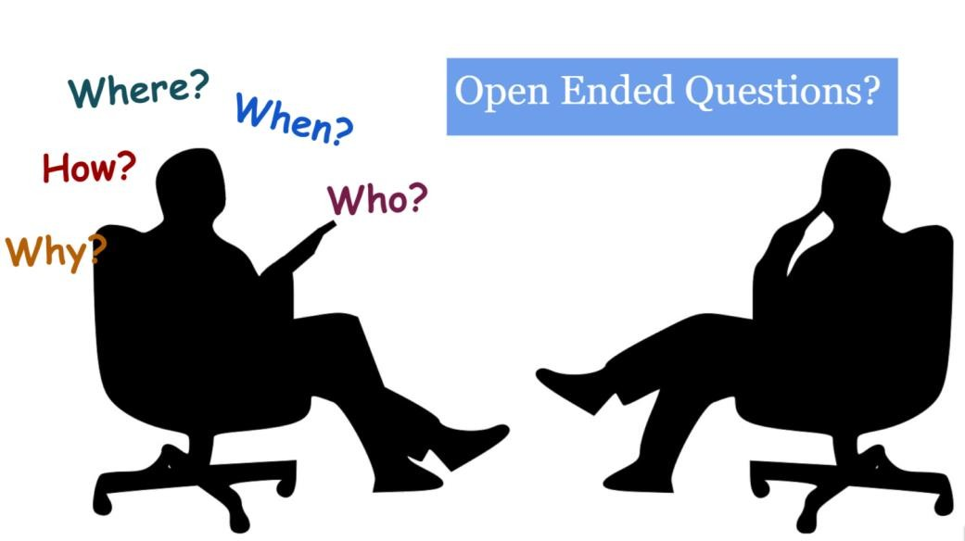
6.2.2 Identify the problem
Open-Ended Questions
Open-ended questions are used to obtain general information.
Allow customers to explain the details of the problem in their own words.

Slide 20
6.2.2 Identify the problem
Examples:
What problem are you experiencing with your computer?
What Software has been installed on your computer recently?
What were you doing when the problem was identified ?

Slide 21

6.2.2 Identify the problem
Closed-Ended Questions
Closed-ended questions generally require a "yes" or "no" answer.
These questions are intended to get the most relevant information in the shortest time possible.

Slide 22
6.2.2 Identify the problem
Examples:
Has anyone else used your computer recently?
Can you reproduce the problem?
Have you received any error message on your computer?

Slide 23

6.2.2 Identify the problem
Documenting Responses
Document the information obtained from the customer in the work order and in the repair journal.
Further, verify the customer's description of the
problem by gathering data from the computer.
Following slides discuss about how to verify the customer description of the problem.

Slide 24
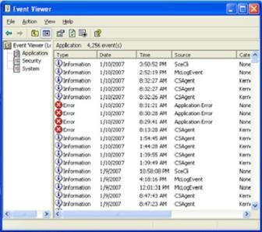
6.2.2 Identify the problem
Event Viewer - eventvwr.msc
When system, user, or software errors occur on a computer, the Event Viewer is updated with information about the errors.
Following types of information can be found.
What problem occurred
Date and time of the problem
Severity of the problem
Source of the problem
Event ID number
Which user was logged in when the problem occurred

Slide 25
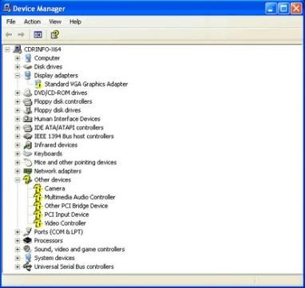
6.2.2 Identify the problem
Device Manager - devmgmt.msc
It displays all of the devices that are configured on a computer.
Any device that the operating system determines to be acting incorrectly is flagged with an error icon.
Yellow circle with an exclamation point (!): Device
acting incorrectly
Red circle with an "X": Device is disabled
A yellow question mark: Hardware not
properly due to unknown driver to install
functioning

Slide 26
6.2.2 Identify the problem
Beep Codes
Each BIOS manufacturer has a unique beep sequence for hardware failures.
Document the beep code sequence, and research the code to determine the specific
hardware failure.
BIOS Information
If the computer boots and stops to determine where to find the problem.
after
the POST, investigate
the BIOS settings
Refer to the motherboard manual to make sure that the BIOS settings are accurate.

Slide 27
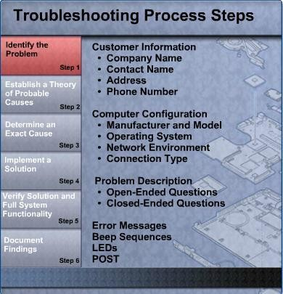
6.2.2 Identify the problem
The outcome of this step would be

Slide 28
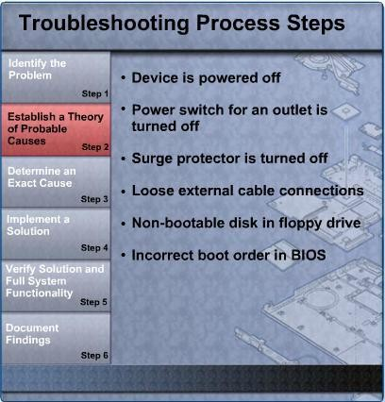
6.2.3 Establish a theory of probable causes
The second step in the troubleshooting process is to establish a theory of probable causes.
Even though the customer may think that there is a major problem, start with the
obvious issues before moving to more complex diagnoses.
For instance, “if the computer doesn’t start”.

Slide 29
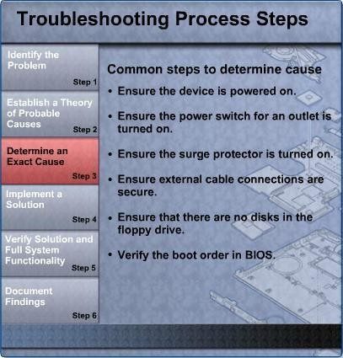
6.2.4 Determine an exact cause
The next step in the troubleshooting process is to determine an exact cause.
You determine an exact cause by testing your theories of probable causes one at a time, starting with the quickest and easiest.
Taking same scenario as before
As you become more troubleshooting computers,
experienced at you will work
through the steps in the process faster.
If the exact cause of the problem has not been determined escalate the problem to a technician with more experience after proper documentation.

Slide 30
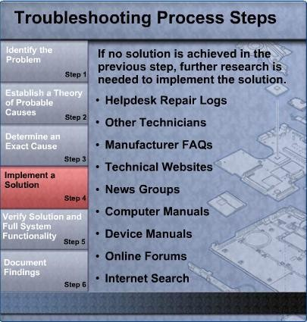
6.2.5 Implement the solution
After you have determined the exact cause of the problem, establish a plan of action to resolve the problem and implement the solution.

Slide 31
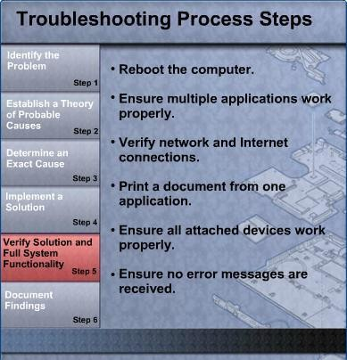
6.2.6 Verify solution and full system functionality
After the repairs to the computer have been completed, continue the troubleshooting process by verifying full system functionality and implementing any preventive measures if needed.
Whenever possible, have the customer verify the solution and system functionality.

Slide 32
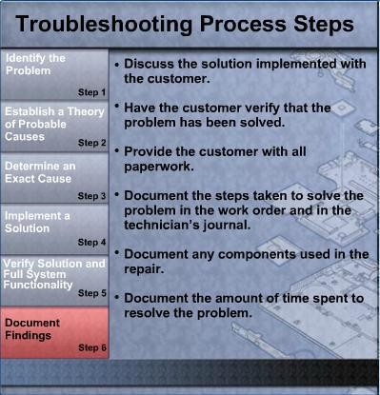
6.2.7 Document Findings
After the repairs to the computer have been completed, finish the troubleshooting process by closing with the customer.
After customer verifies the resolved problem, complete the documentation for the repair in the work order and in your journal.

Slide 33
End of Lecture 06

